Slide 1
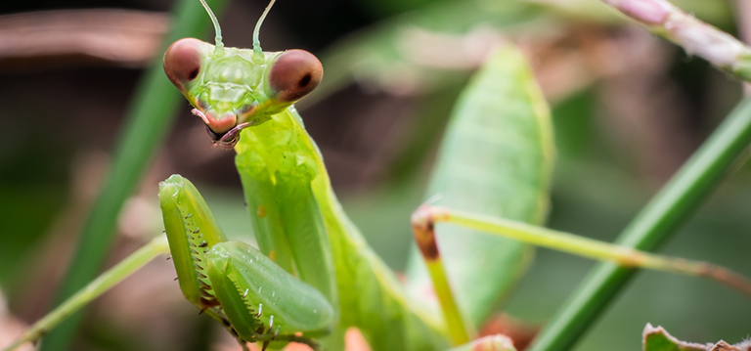
Mantis
April 30th 2019

Slide 2
Overview of presentation
History/Research
Input
Engine details
Output report
Theory of operation
Front End interface with Engine
DEMO

Slide 3
Mantis origin

Slide 4
History/Plan
Upon meeting, we decided to have weekly meetings
We believed it would be ideal to do so because we would be able to keep everyone on the same page and to discuss any issues or questions

Slide 5

History
We began researching various systems to get an idea of what was to be done as we created the SRS document
MOSS simple, code changed to tokens, and looks for matches of lines and tokens between two source codes
Jplag, similar idea, tokenizing

Slide 6
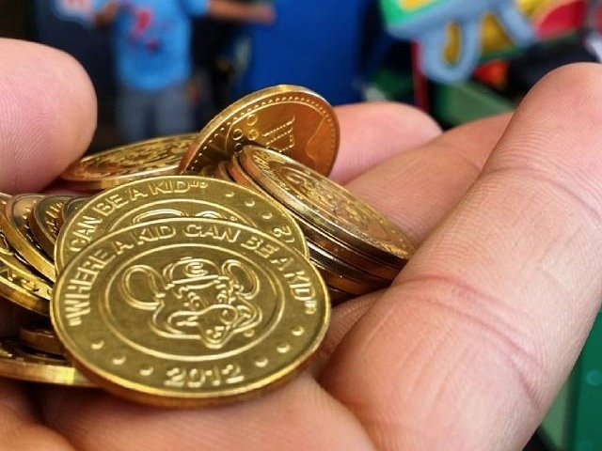
planning
From research we realized that some sort of tokenizing and comparison of those tokens is what needed to focus on in order to have an effective algorithm
For our interface we wanted to use technology that was current, so we decided to go with Microsoft Azure, a cloud based service for full application and service development

Slide 7
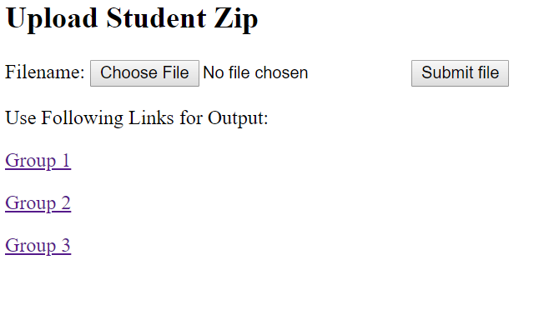
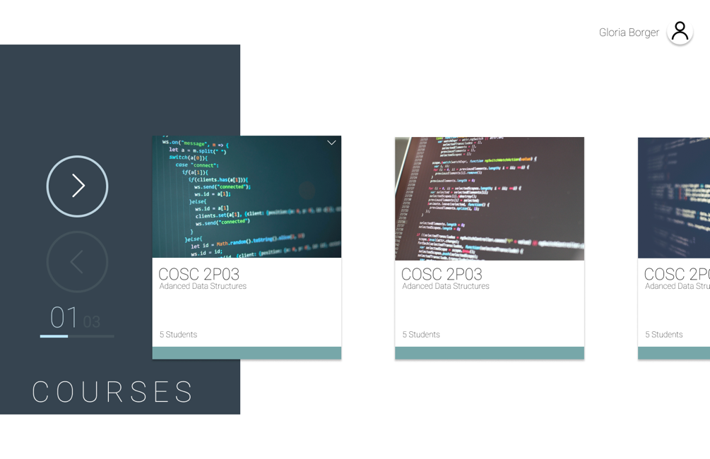
User interface
Students and teachers have access to our Mantis plagiarism checker from our user interface online

Slide 8
Input
Our inputs will be source codes for specific programming languages, in our case Java
Users can upload a zip/folder as their assignment
With project folders, there are many files that are not actual source code
We needed to remove these files and keep source code only

Slide 9
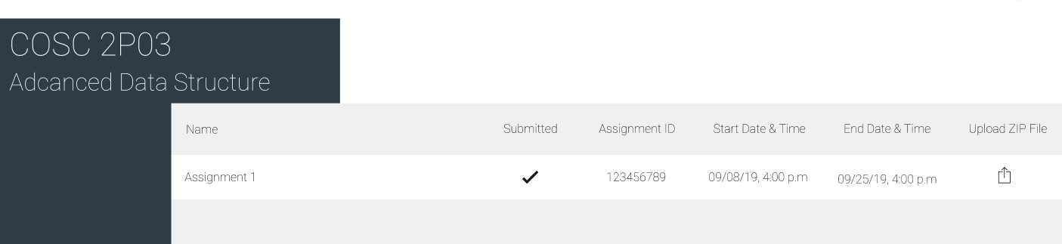
Unzip files and removing useless files
The website is able to unzip files and deduce whether the file submitted is correct, if it is not, then the file that is improper is removed
Using PHP command or Java

Slide 10
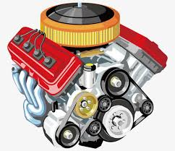
Engine
The engine consists of the tokenization and similarity check of code
After the input step
Using metrics and statistics from the engine, we will use this information to then form the output and its report for teachers to see results

Slide 11
Tokenization
Using various tokenization techniques, each word and symbol will be converted into tokens based on their category and purpose within the program, in order to make the algorithm for checking assignments work on basic variables
We wanted to be able to generalize data structures and other things used in programs to be able to compare with others after

Slide 12
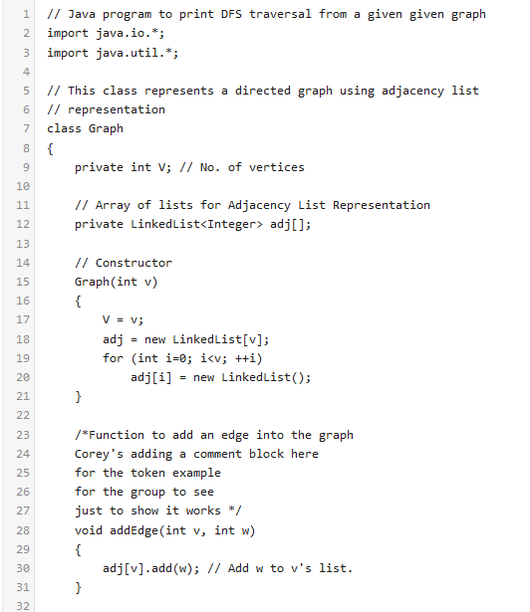
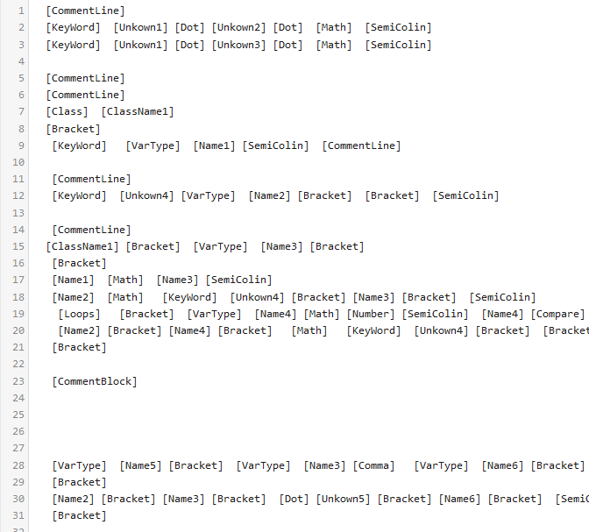

Slide 13
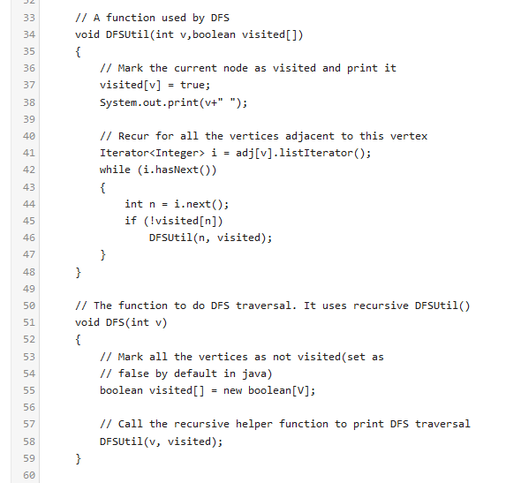
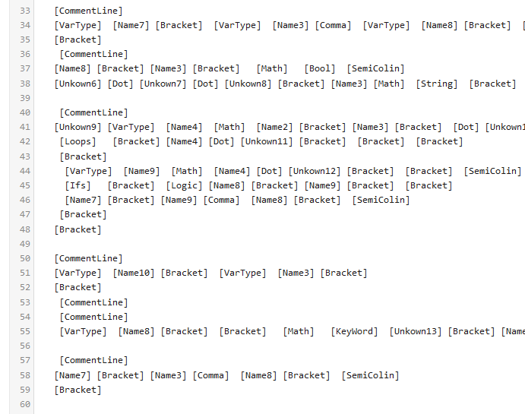

Slide 14
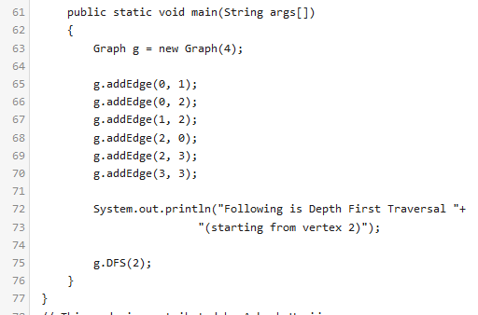
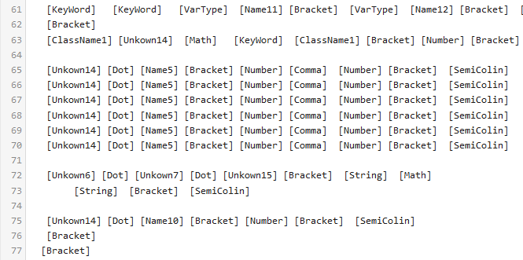

Slide 15
Programs
Copy
Original
public double cF (Item i, Calendar cDR, Calendar cDD) {
double f;
long m = cDR.getTimeInMillis() - cDD.getTimeInMillis();
int d = (int) (m / 86400000);
f = d * i.finePerDay;
return f;
}
public double computeFine(Item item, Calendar calDateReturn, Calendar calDateDue) {
double fine;
long milli = calDateReturn.getTimeInMillis() - calDateDue.getTimeInMillis();
int day = (int) (milli / 86400000);
fine = day * item.finePerDay;
return fine;
}

Slide 16
Tokenized
Copy
Original
[KeyWord] [VarType] [Name1] [Bracket] [Unknown1] [Unknown2] [Comma] [Unknown3] [Unknown4] [Comma] [Unknown3] [Unknown5] [Bracket] [Bracket]
[VarType] [Name2] [SemiColin]
[VarType] [Name3] [Math] [Unknown4] [Dot] [Unknown6] [Bracket] [Bracket] [Math] [Unknown5] [Dot] [Unknown6] [Bracket] [Bracket] [SemiColin]
[VarType] [Name4] [Math] [Bracket] [VarType] [Bracket] [Bracket] [Name3] [Math] [Number] [Bracket] [SemiColin]
[Name2] [Math] [Name4] [Math] [Unknown2] [Dot] [Unknown7] [SemiColin]
[KeyWord] [Name2] [SemiColin]
[Bracket]
[KeyWord] [VarType] [Name1] [Bracket] [Unknown1] [Unknown2] [Comma] [Unknown3] [Unknown4] [Comma] [Unknown3] [Unknown5] [Bracket] [Bracket]
[VarType] [Name2] [SemiColin]
[VarType] [Name3] [Math] [Unknown4] [Dot] [Unknown6] [Bracket] [Bracket] [Math] [Unknown5] [Dot] [Unknown6] [Bracket] [Bracket] [SemiColin]
[VarType] [Name4] [Math] [Bracket] [VarType] [Bracket] [Bracket] [Name3] [Math] [Number] [Bracket] [SemiColin]
[Name2] [Math] [Name4] [Math] [Unknown2] [Dot] [Unknown7] [SemiColin]
[KeyWord] [Name2] [SemiColin]
[Bracket]

Slide 17
List of Tokens 1
Token | Replaces
[CommentBlock] (Deleted in Short Form) | Everything between /* and */
[CommentLine] (Deleted in Short Form) | Everything after // on that line
[String] | Everything between quotation marks “
[SemiColin] (Deleted in Short Form) | ;
[Colin] (Deleted in Short Form) | :
[Dot] | .
[Comma] | ,
[Array] | [] [2] [24] [35326]
[Bracket] | ( { [ ) } ]
[VarType] | int long char bool/boolean
[Compare] | != == >= <= > <

Slide 18
List of Tokens 2
Token | Replaces
[Logic] | ! && || ?
[Bitwise] | ~ & |^ >> << <<<
[Output] | Print Println Printf / cout cerr clog
[Loop] | For while do
[If] | If else
[Class] | Class
[Return] | return
[Keyword] | 35 java word / 50 C++ words
[Bool] | true false
[Math] | * + - / ++ -- %

Slide 19
List of Tokens 3
Token | Replaces
[VarName#] | Any unknown word after a VarType token
[ClassName#] | Any unknown word after a ClassName token
[ClassInstance#] | Any unknown word after a ClassInstance Token
[Number#] | Any series of digits
[Char#] | Anything with one character between ‘ ‘
[Unknown#] | Anything not already converted to a token

Slide 20
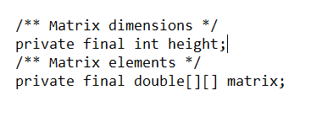
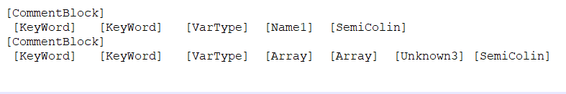
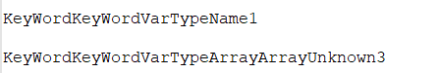
Example 1

Slide 21
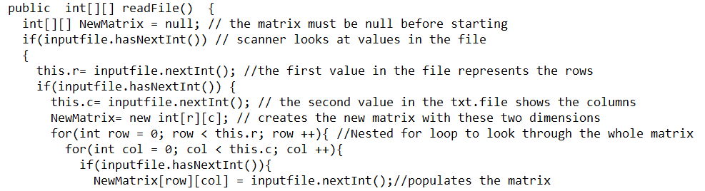
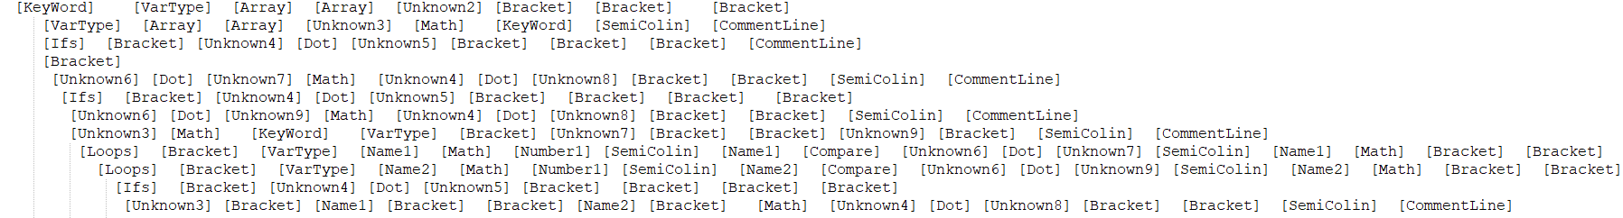
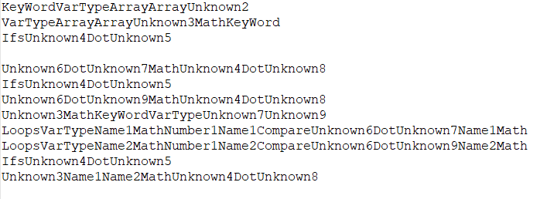
Example 2

Slide 22
Changes during development
Don’t let it get stuck in infinite loop
Make it properly detect words and symbols when there are not spaces between them.
Detect if which programing language the file is in
Have the token program handle the file structure sent to it, and output the tokens in the correct file structure for the next part to work.
Optimize the token format so it works best with the similarity check.

Slide 23
Similarity check with our algorithm
Using our similarity algorithm, we compare assignments with each other
Matching tokens are stored, and a cosine similarity value is generated for the two programs
This similarity gives us an idea of the percentage of similarity between the assignments
Demonstration

Slide 24
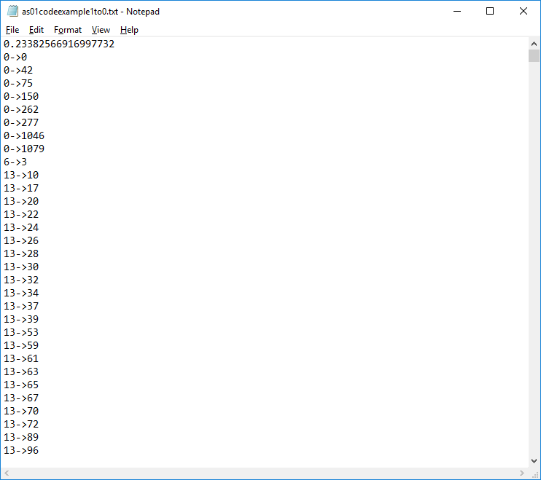
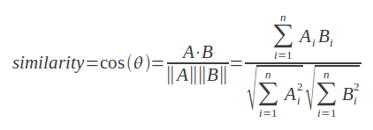
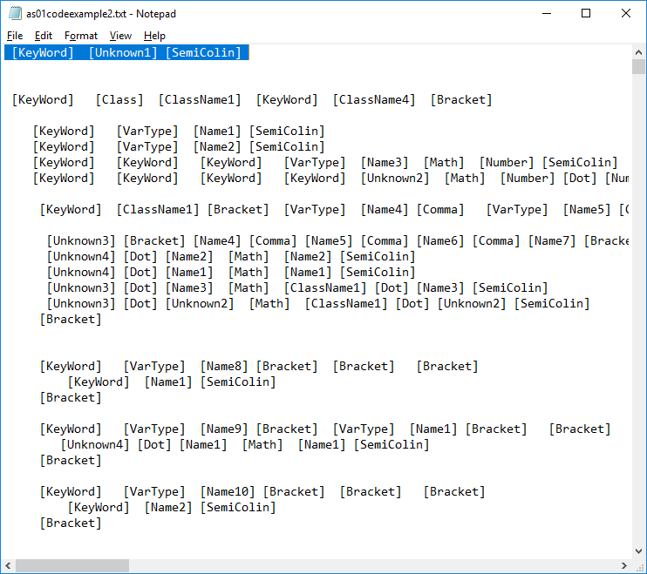
Result
Output
Definition and function

Slide 25
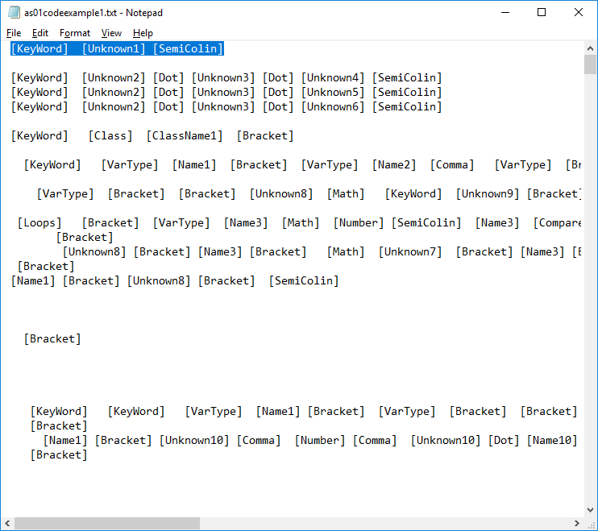
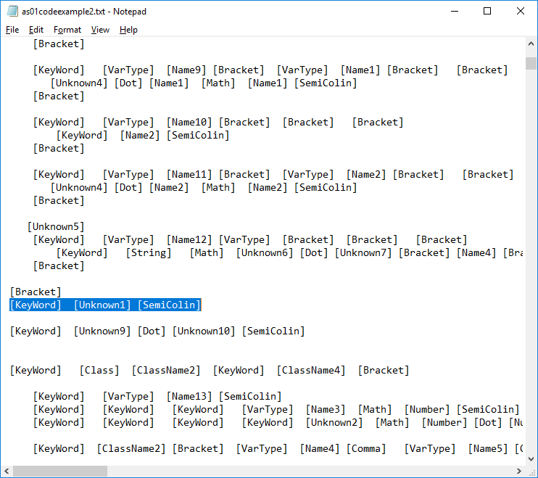
Check 1: cosine similarity
Copy
Original

Slide 26
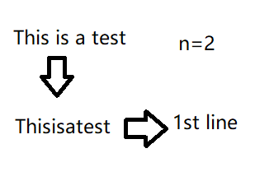
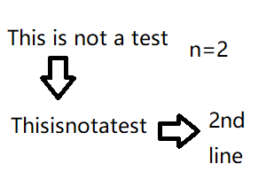
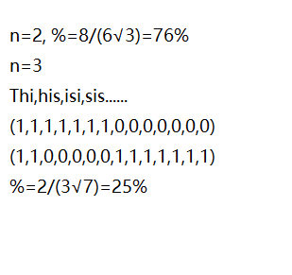
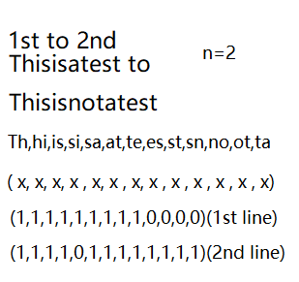

Slide 27
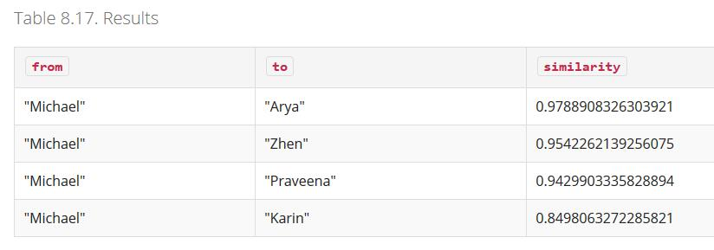

Slide 28
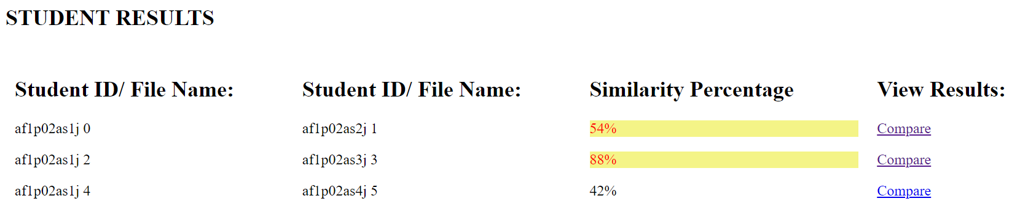
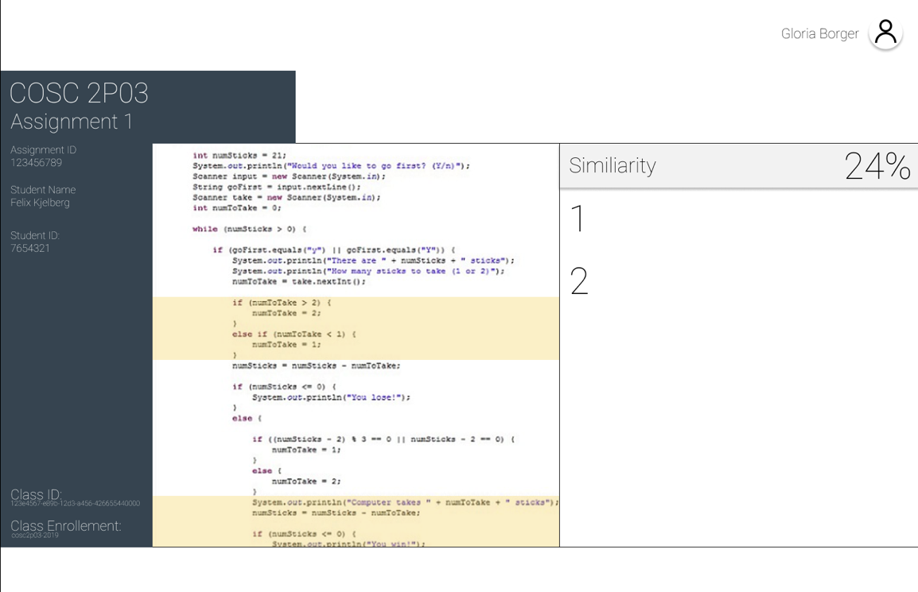
Output report
Given the information, we are able to generate a report that is available for viewing by the teacher

Slide 29
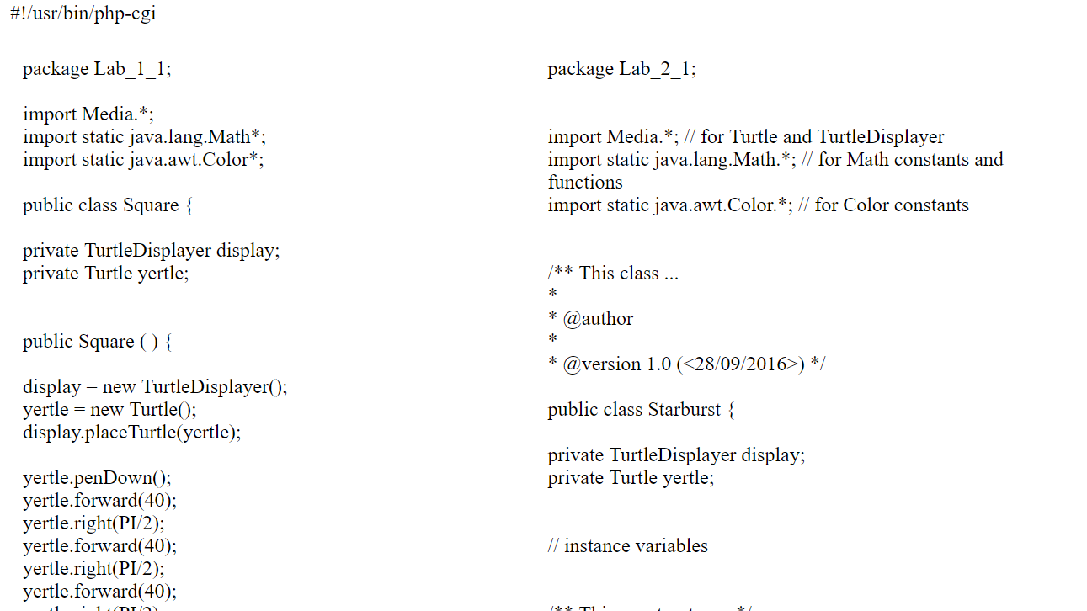

Slide 30
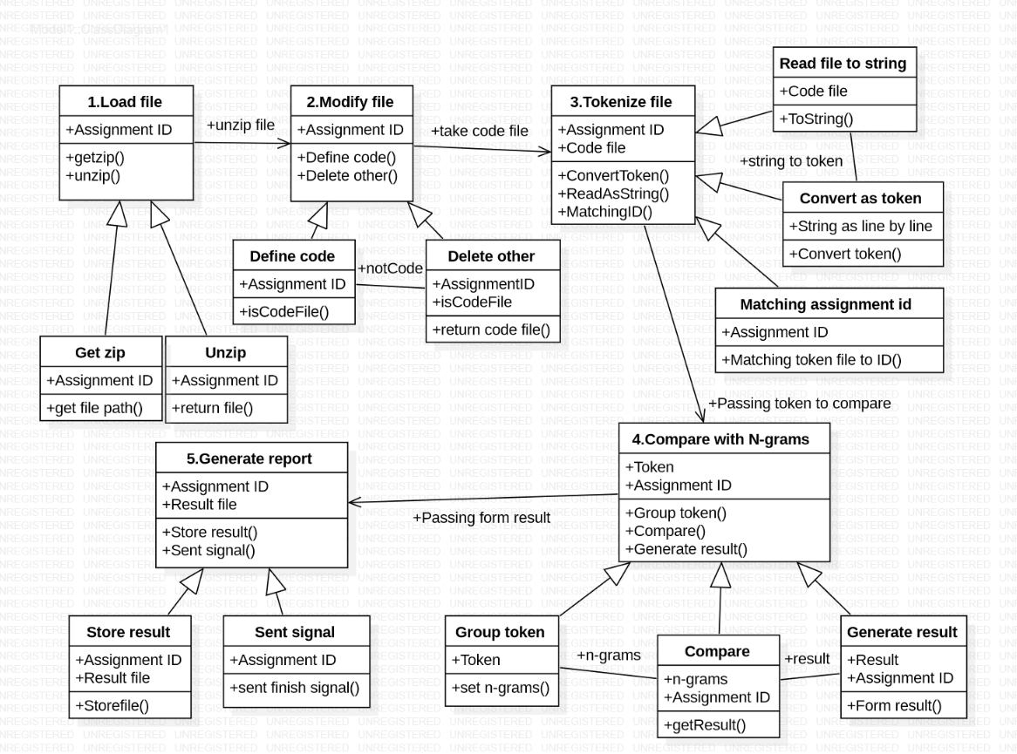
Theory of operation

Slide 31
Theory of operation
The two basic users that will be using this system would be a student and a professor
The student simply wants to upload their assignments online for checking
The teacher simply, wants to view a report of similarity between source codes in a simple and accessible manner for their students work so they can make an accurate decision

Slide 32
Front end 2 engine

Slide 33



Slide 34
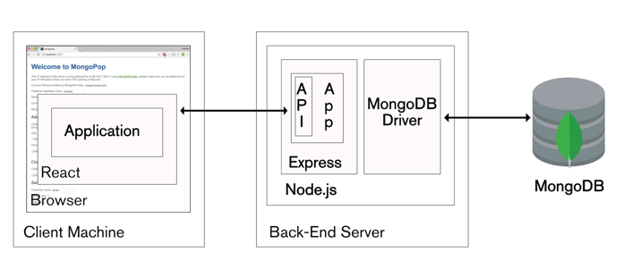

Slide 35
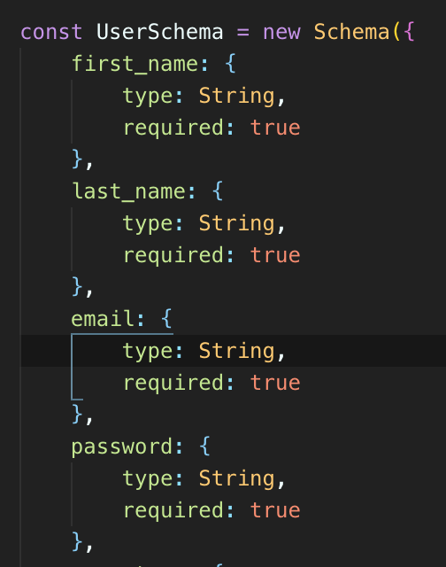
Mongo DB
NoSQL database
Document based
Mongoose
Logic
validation

Slide 36
Node.js
Javascript runtime environment (server side)
Runs back-end application via express
Asynchronous, event-driven engine

Slide 37
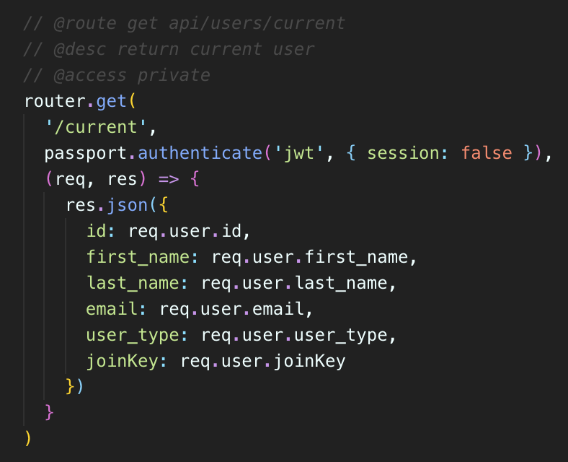
Express
Module in Node.js
REST api

Slide 38
React and Redux
Javascript front-end library
Builds user interface via JSX
Virtual DOM vs DOM
Component level state vs. application level state

Slide 39
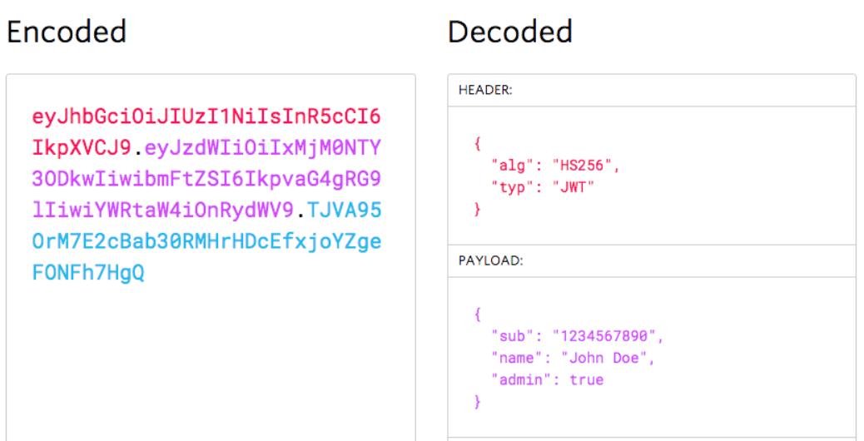
JWT Web Token
- Jwt token
- Bearer token

Slide 40
demonstration
Please refer to our demonstration laptop

